Slide 1
active and passive voices
                PREPARED BY
                V.PAVITHRA
                ASSISTANT PROFESSO OF ENGLISH
                JAMAL MOHAMED COLLEGE

Slide 2
The active and passive voices are the two grammatical voices.
Voice refers to the form of a verb that indicates when a subject acts or is the receiver of the action.
When the subject performs the action it is active voice and when the subject receives the action it is passive voice

Slide 3
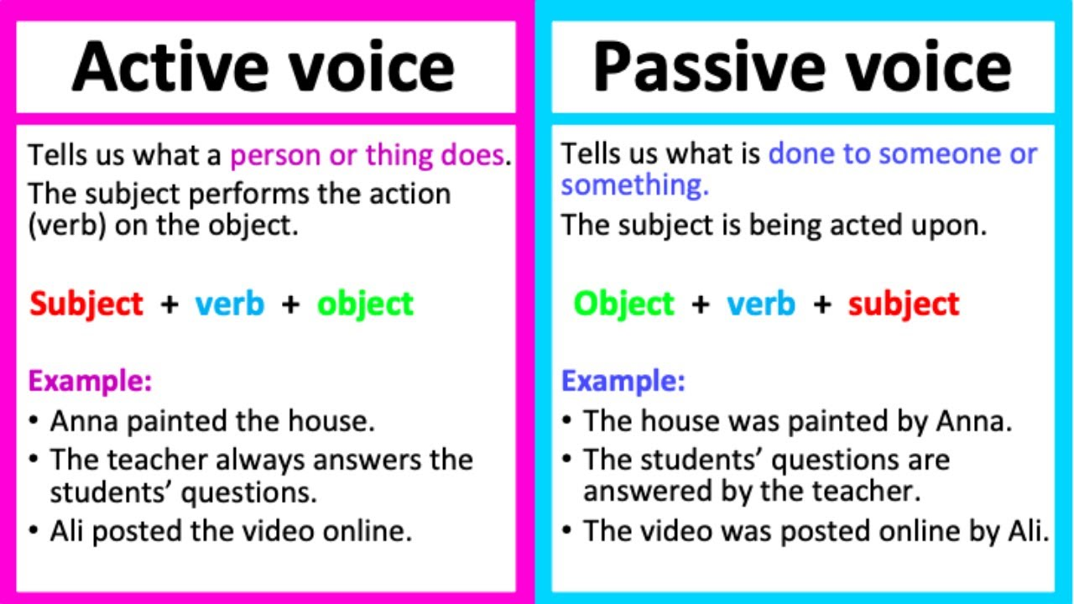

Slide 4
Rules for Conversion of Active and Passive Voice
The rule for conversion from active voice to passive voice is as follows-
Rule1: First and foremost, identify the subject, verb, and object(S+ V+O) in the sentence to convert to passive voice.
Rule2: Then interchange the object and subject with each other, that is, the object of the active sentence becomes the subject of the passive sentence.
Rule3: Change the base verb in the active sentence into the past participle(third form of the verb) in a passive sentence.
Rule4: The word by will be used before the subject in passive voice.
Rule 5: The pronoun in the sentence will also be changed

